Slide 1
On Becoming the Observer /
Meditation
By David E. Hopper
Notes:
Becoming the Observer and Meditation
Today, I’ll be discussing some preliminary info on purification, then moving on to Becoming the Observer, and continue with discussing the importance of Meditation.
Before we begin, I want to re-state several key themes regarding the Soul’s spiritual journey.
Merging the 3-Fold Personality (i.e. the Mental, Emotional/Astral and the Physical / Etheric) with the Soul to create Personality integration and At-one-ment with the Soul
Purification of Astral and mental bodies are ongoing
Purification allows for clear seeing, expansions of awareness and recognitions
This process, is about deepening a Soul connection through meditation.
While this is happening, Buddhi is replacing the lower Astral matter and energies to offset glamour and illusion.
These concepts allow you to see yourself as you are and know your purpose.
Know the importance of Service.
Reminder: I’ll be referencing the Handouts in the class. For this class there are two new handouts: “Stages of Meditation” and “Techniques for working in Consciousness”. These two handouts are already posted in the Makara website, and I’ll ask that Michael make the links to these files available in the Chat box.

Slide 2
Purification is Ongoing
Tune into Thoughts - Feelings
Notes:
Purification is Ongoing
We are reminded that purification is ongoing and a necessary process that begins during the Probationary Path and continues for the disciple and initiate up through the higher Initiations. Treading this path is an exact science and requires all limitations be overcome in order to progress on the Path. Purification is about purifying the mind and astral body of anything that is not of the Soul’s nature and keeps you from experiencing a full integration with the Soul.
The Teachings which I’m imparting from the writings of AAB / DK are not just about purification techniques and information about taming the lower astral and mental bodies. This information about the transformative power of the Soul that “shocks the aspirant or disciple” into action. I provide technical knowledge, but in the end it is your own intuition that must be awakened to guide you in the process.
During the time of probation and discipleship, learning self-control over your thoughts, feelings, and actions will pave the way towards preparation of greater expansions of consciousness, and service.
When you purify your thoughts and emotional bodies, you are actually making them better receptors for the Soul’s light.
We note that purification also depends on several things:
Your own willingness and commitment to expanding your awareness is key.
Our task IS NOT to get rid of these energies or judge them per se, but acknowledge they are limiting factors in expanding your spiritual work. These can be addressed by applying mental techniques to overcome and transform the energies into something more life-giving.

Slide 3
Hinderances and Obstacles
Transforming Your Dark Side
Four Limitations
Notes:
Hinderances and Obstacles
A major concept to grasp about purification is that as you are progressing from one state of awareness to a higher one, this is achieved by overcoming the hindrances present at each stage. This is accomplished through the science of purification.
Dealing directly with your own personal obstacles and hinderances is in reality dealing with some of your most overt dark thoughts. On the path of Liberation, each of us personally and individually must take responsibility and deal with the lower thoughts and feelings that keep us separated from each other and from our own Souls. These thoughts and feelings can be either conscious or unconscious.
For this subject of dealing with your dark thoughts, I am recommending that you don’t repress your dark side, but learn to transform it. This means that you should stand back in consciousness, learn to see your dark thoughtforms with dispassion. Using dispassion will take the charge OFF the thoughtform. Keep in mind that thoughtforms and desires are nothing more than energy and can be transformed.
The 4 most limiting energies of the dark side that need to be overcome are:
Anger
Anger poisons the mind and blocks the expression of love from the Soul. This energy must be mastered and contained before moving onto higher levels of consciousness. The energy of anger or ill will or Harmfulness will cripple your service to others, and inhibit your progress on the path.
Selfishness – “Me Only” consciousness
This energy causes the individual to do whatever he sees fit, as he is expressing a ‘me only’ awareness. This can be a passive-aggressive attitude, deception, lying, lack of kindness or compassion; I’m in it for me, my family only”, my nation or race”, etc. This blocks out any expression of the Soul, and separates the individual from others.
Addressing this energy is about transforming your own personal will into an expression of the Divine Will.
Fear and Worry
Fear has two possible expressions:
Fear can paralyze the spiritual seeker from moving forward.
Fear can also be a motivator when courage, in combination with consciously knowing what needs to happen in the moment is present. This can involve an instinctual or strong Soul presence.
Unbalanced Desire
In its most basic form, unbalanced desire is an “I want this” energy and works with the energy of selfishness and expressing one’s own will. When unbalanced, it can cause the individual to have dysfunctional behavior in the form of eating disorders, drinking, drug abuse, theft, gambling, and mis-applied sexual energy, or cause the person to have overly aggressive feelings.
Any of these 4 energies block Soul expression.
Other hinderances and obstacles to overcome in the beginning /intermediate stages:
Restlessness, i.e. dealing with “Monkey Mind” chatter
Carelessness…not thinking or being mindful of your environment
Laziness - Lack of Discipline
Apathy or Boredom
So by observing and detaching from these hindrances, requires moral strength as a predominant requirement to change your character and ask why you are on the Path?.
Later in this talk, I’ll spend some time talking about techniques to overcome these limitations.

Slide 4
Advanced Purification
Balancing Pairs of Opposites
Divine Will vs. Lower Will
Notes:
Advanced Purification
For the advanced disciple, i.e. he or she who has dealt with much of the “dark thoughts”, his next step in purification involves working with the concept of duality or the pairs of opposites. This happens at the Soul level. Keep in mind that the disciple emerges from the path of purification and onward to the Path of Transformation – i.e. transformation in emotion and thought.
In this context, his consciousness becomes a battleground, where he stands between the two great forces as the Observer and he realizes his struggle is between his own selfish will, i.e. the Personality and that of the Soul and the higher Divine Will. In the end, he will release his own “separative” will and choose the higher Divine Will over all things related to the form and the pulls of the astral nature.
Examples of working with duality in consciousness:
Balancing the Male-Female interrelationships and energies
Learning and Knowing what is best for the group (society, company, family) vs. one’s own selfish interest
Knowing one’s own limited and personal will vs. the Divine Will
Reconciliation occurs mostly at the 2nd Initiation where the energies of Buddhi purify the lower emotional and separative energies.
At the 3rd initiation, the Dweller on the Threshold and the Angel of the Presence come together to bring balance and complete At-onement with the Monad.

Slide 5
Stages of Observer
Mental Observer
Pure Awareness
Non-Duality
Notes:
Stages of the Observer
Although becoming the Observer and meditating go hand in hand, we will consider becoming the Observer as a necessary first step prior to meditating. The main purpose for becoming the Observer is to guide in the purification process. Once again, we are reminded that the activities in consciousness happen over a long periods of time! Becoming the Observer happens in stages, and plays an important role on the Path of Liberation.
There are 3 distinct stages for becoming the Observer.
Stage of Mental Observer
In the initial stages of going within, you observe …using a mental focus as you peer into the void of your mind. In this stage the lower mind itself holds the observing awareness. Here you are aware of the contents of your mind, your desires, thoughts, and the forces of your etheric body.
Stage of Pure Awareness
In this stage, the Soul is experienced as awareness. You steadily look within to see what you are and come to the awareness that you are the one who is observing, with pure perception, pure consciousness, and pure seeing. The sense of "I" is strong, and the duality of "self and other" is fully present.
In these first two stages, you realize you have been developing and expanding your consciousness.

Slide 6
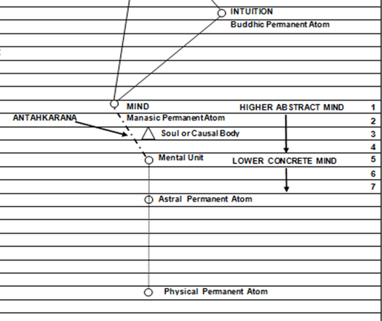
Stages of Observer
Stage of Non-Duality
Notes:
Stage of Non-Duality
In the advanced stage of pure awareness, the ‘I’ awareness of the Personality-Observer, or the one who has been observing…and it disappears all together – as there’s just One awareness, that of the Buddhic Plane. [CHART] There we discover our nature is one of radiance, where all creation is experienced as a manifestation and expression of the Higher Self. We see that the "Soul" is not something located somewhere within or even outside our own nature, but you come to see yourself and Higher Self in everything. But realize the Divine, by its nature is – non-Dual, i.e. there’s no separation of any kind. So at some point you will have to relinquish your separative “I” nature and completely at-one or merge with the higher consciousness.
This understanding provides a pathway for purification to clear out ALL that blocks you from becoming One with the Divine. This is an unswerving focus upon initiation and upon awakening to the non-dual Reality, and the unfoldment of the naturally existing “Divinity” within.

Slide 7
Working as Observer
Observing is “Listening” with the mind
Notes:
Working as the Observer
You will gain a deeper understanding of your own nature and function of your mind thru the study of becoming the Observer. Why is this important?
It’s a subjective realm where all your thoughts and feelings are present and also a place where you can come to an awareness of the Higher Self – the Soul.
Initially, you will observe errant energies present and need to purify them so you can enable clear seeing. Thru observing the mind you as the spiritual seeker will learn to work consciously with force (expression of the will) and energy, i.e. observing your thoughts, feelings, and actions.
By going within, you come to know the forces and energies present whether inside or outside of you. Regardless, they are in your consciousness and you must deal with them. During the process of observation you are learning about your limitations (i.e. hinderances) and your strengths (those that aid you).
Keep in mind that being the Observer never goes away, even after meditation in your waking state as you are keenly sensitive to all energies present. Sensitivity here is about developing something called the “Esoteric Sense, which I’ll go over a little later.
You will come to know that stilling the mind and the emotions is not enough as you will want to know ABOUT the process of transforming your lower thoughtforms and practice mental techniques.
How will you do this?
Initially, thru spiritual study, you will seek out whatever teachings that inspire or provide insight, you will learn methods of purification and expanding awareness.

Slide 8
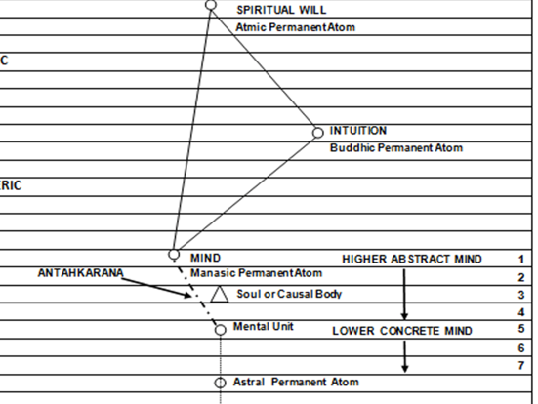
Working as Observer
Notes:
As much as you align with the Soul, you will observe how your inner nature is changing. You are focusing and learning on how hold your consciousness, while observing and listening on the mental plane where the Soul resides. [CHART]
You are learning to allow the lesser self to withdraw into the background, and let the Soul's energies flow unimpeded.
You learn to practice dispassion and harmlessness, especially when reactive feelings and energies are present.
You eventually transform the mind in stages thru the paths of Probation and Discipleship.

Slide 9
How much Harmlessness
Do I Practice?
“….in thought, feeling and action”
Notes:
How Much Harmlessness Do I Practice?
While still on the subject of becoming the Observer, let’s explore some other themes…
On the spiritual path there are many higher Soul qualities to cultivate and embrace. Among the most important is “harmlessness”.
Harmlessness is a mindset and practice that is important to bring forth for all encounters with people and situations in your environment. Why? When connecting with the Soul you will quickly find that its nature is of love and goodwill. The practice of harmlessness is a bridge to the higher planes and spiritual growth. There is a saying:
“You cannot approach the Master until you have lost the power to do harm”….this is in thought and action, or a re-alignment of the Personality.
It is recommended to study yourself and see how harmfulness and harmlessness have on others. This can be done during meditation, or an evening review by analyzing:
Your Emotions
….. on others, so there is no mood, depression, nor emotional reaction that can harm your fellow man. Ask: Am I reacting or responding? Violent aspiration, misplaced, or misdirected energy may harm others, so look not only at your mis-aligned tendencies, but how you express your values.
Your Actions
If you are harmless in your actions, remember how this looks and feels. Practice and BE the example!
Your Thoughts
Attempt to be harmless and eliminate harmful states of thinking.
Harmlessness brings caution in judgment, reticence of speech, ability to refrain from impulsive action, and a demonstration of a non-critical spirit.
Harmlessness is an attitude of one who lives consciously as a Soul, whose natural inclination is love, and whose method is inclusiveness, not separation.
I’ll be speaking in greater depth about spiritual study in January’s talk.

Slide 10
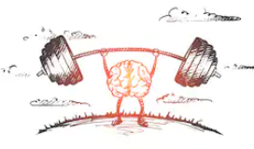
Transformation of Thought
“What is my Motivation?”
Awareness of Forces / Energies
Notes:
Transformation of Thought
There’s an old esoteric axiom: Energy Follows Thought. This means whatever you focus on, or in whatever direction your mind goes, so will be the direction of your thinking. If you are thinking of “I want to get ‘X’ for my own self,” then these thoughts, in combination with Will and desire, will drive you to carry out his task, regardless of whether you create karma for yourself. In short, you bring life and vitality to your thoughts.
When aligning your mind with the Soul, eventually the lower mind will become more Soul infused. Here, the light of the Soul as an energy, is transforming your thoughts so you become a conscious creator in thoughtform building. Ask yourself often: What is my motivation when creating thoughts in all my actions?
The esotericist or one who is aware of forces and energies in the environment, knows and understands the appropriate use of the mind is for creating thoughtforms for carrying out the Soul’s purpose, and not for the selfish needs of the separated Personality. It is this Soul-driven mindset that allows you to know that you should never force yourself on others while engaging in any activity.

Slide 11
Transformation of Thought / Emotional Energies
Notes:
………Continuing on the theme of Transforming your Thought and Emotional Energy
Redemption / Reorientation of Personality Vehicles
While connecting with the Soul either through meditation or being the Observer, you are in fact redeeming and reorienting, i.e. upgrading your lower vehicles. Probably most of the time, this happens in the background of your conscious mind.
Redemption in the esoteric context is an act of transformation of the etheric matter of the lower 18 planes of your 3-Fold nature, and replacing it with the higher / finer energies of the Spiritual Triad, namely Buddhi. [CHART]
In practical terms, the energies of Redemption / Reorientation will over time transform any tendencies of harmfulness, selfishness, and irrational behavior. This will result in all lower emotional and mental plane reactivity becoming neutralized and raised up. In this example, the astral substance is redeemed or upgraded, and is replaced with pure reason from Buddhic plane. While in meditation, the Soul’s light will do the job of redemption and transformation of the lower matter.

Slide 12
Right Thoughtform Building
Re-Pattern
and Vitalize your Thoughts
Notes:
Right Thoughtform Building
In today’s world, people build thoughtforms for both light and dark purposes. Our purpose here, is for you to become conscious of all things in your own consciousness, and want to create thoughtforms from the place of the Soul and NOT the Personality.
Your task as a spiritual seeker is to impose a new and higher rhythm to your thoughts to awaken the power to think clearly and accurately.
As the Observer, you will offset errant thoughtforms by observing the energy, knowing its limitations, and creating its polar opposite. If for example, there is an anxiety or impatience in the emotional nature, then it can be overcome with calmness and patience. …or you will replace control and attachment with dispassion and detachment.
In GWP, the chapter “Ending of Glamour” has numerous techniques for doing this + my handout “Techniques for working in Consciousness”
Here, you are learning to hold a “transformational” thoughtform, and it allows you to attain a higher spiritual objective, and thus transform the condition or situation in your life thru a conscious effort.
While in meditation or as the Observer, you are learning to re-pattern your limiting thoughts. This means that you are focusing and holding your awareness on a mental level of the Soul and not driven by your emotional-reactive nature.
We’ll experiment a little with this in the Observer meditation today.

Slide 13
Comprehension
What are You Learning?
Create New Intentionality
Notes:
Comprehension
We’ve examined some hinderances and obstacles. As you are moving on the path, you want to have a deeper understanding about your integration with the Soul. Observation here doesn’t necessarily have to be in or during meditation. It can also be in quiet reflection during spiritual study or attentiveness in the waking mind.
Important to ask…..what are your spiritually learning and Comprehending?
It should be a teaching or more advanced study about controlling all that you think, and to be able to re-pattern those thoughtforms that don’t work for you. If you have an issue, look at yourself honestly and decide the best course of action.
Mantrams and Affirmations can help to focus thoughts for re-patterning or overcoming emotional hindrances…..You many want to search out specific affirmations for focus on purifying the emotions and reactivity. I’ve included some suggested affirmations.
Handout: Terminology….Page 2…..Affirmations / Mantras
Spiritual Study develops knowledge and Intuition – from this you gain experience and understanding or communication with the Soul that Intuition is developing – You are sensing what and why you doing something and determining the source of the material in question.
Identification – with thoughts and phenomena in your inner world – as part of yourself and NOT somebody else’s. Be aware of this process and take responsibility.
Discrimination / Discernment – learn to make wise conscious choices in thought and action; for example learning about right / wrong …..“do I see this situation in stark terms or are there shades of gray?”
Learn to Create a new Intentionality with your thoughts and mind by making all of your life an activity of Soul purpose…..learn to trust the intuition.

Slide 14
Esoteric Sense
Subjective Awareness of Inner and Outer Plane Life
Notes:
Esoteric Sense
The term “esoteric sense” denotes a gradually developing spiritual power in the disciple, who has developed a measure of alignment and integration with the Soul.
The esoteric sense allows you to:
Live and function subjectively on mental levels and the lower 18 subplanes. The disciple holds an attitude, which can orient in both the inner and outer planes.
Possess a constant inner contact with the Soul. This marks a transcendence of personality issues and allows him to have complete control over his emotional life.
Actively demonstrates love and wisdom in all he does through goodwill, cooperation and loving understanding.
It allows him to mentally tune into the realms of thought and ideas. You can choose those mental concepts and ideals, which will be recognized in the world of everyday thinking, and living.
To cultivate the esoteric sense, you know that meditation is required. As time passes, this results in developing an attitude of a mind with detached thoughts and emotions.
The esoteric sense can be cultivated by holding the attitude of the Observer during meditation, spiritual study AND in your waking state.

Slide 15
Importance of Meditation
The Mind’s “Natural State”
Notes:
Importance of Meditation
A note on Meditation as I’m teaching it, the Morya Federation is using different types of meditation. What I’m teaching here will in NO WAY conflict, but indeed can enhance or supplement deeper connections with your Soul.
In essence, this type of meditation is about communing with the Soul, or Higher Self for achieving an experience of pure Awareness and Beingness without thought.
Meditation is the first of three pillars of a spiritual practice. I will be addressing the other two, Spiritual Study and Service in the January and February talks.
If you are consciously on the spiritual path, then you should be learning to meditate. Meditation is the best way to integrate your mental-emotional and physical-etheric form (i.e. the 3-Fold Personality) into a sensed “Oneness” with the Soul.
Meditation describes a process of how the mind is in its true or natural state. In this teaching about meditation, you are not trying to create a peaceful state per se, but rather have a “direct experience” of who you truly are in your natural state.
What is your Natural State? The Soul’s consciousness is your natural state.
Learn to put aside all limiting thoughts and feelings such as anger, separatism and a “Me Only” mindset so you stand in a state of “pure Beingness” and “pure Awareness” of the Soul.
This will not happen immediately, but gradually over long periods of time.
Meditation is about stilling the body, thoughts and the emotions thru the mind. Using mental techniques, the mind becomes calm. Then what?
You learn about who you are, and about the forces that make you up….You will have to learn how to transform the mind using certain Techniques so that it can be a useful tool for expressing the Soul’s purpose, which ultimately is service.
In the January class, I’ll be talking in depth about “Service” .
By establishing a stabilized consciousness, you will see yourself as becoming more conscious and awake in all that you do and in both your inner and outer life.
Handout: 9 Stages of Meditation…..I provide this handout as supplemental information. It describes a basic understanding of the stages and what you will encounter until spiritual liberation is achieved.

Slide 16
Prerequisites for
Meditation
Notes:
Prerequisites for Meditation
Real progress in meditation requires establishing the right conditions in your meditation environment, i.e. your mind.
Here are some very practical methods for providing a good foundation for a meditation practice:
Calm space – surroundings that are noise free and peaceful, e.g. turn off your phone.
Stop flow of intellectual thought – this has to do with fantasy-daydreaming, and intellectualizing the teachings….you the meditator may be using your imagination for fantasy purposes, and this distracts you from focusing on making Soul contact.
Life of pure ethics – for example right living and harmlessness. Needless to say, harmful activities in heart or mind will greatly disturb the mind, such as lying, stealing, or engaging in harmful activities. These actions create karma and negatively impact the mind.

Slide 17
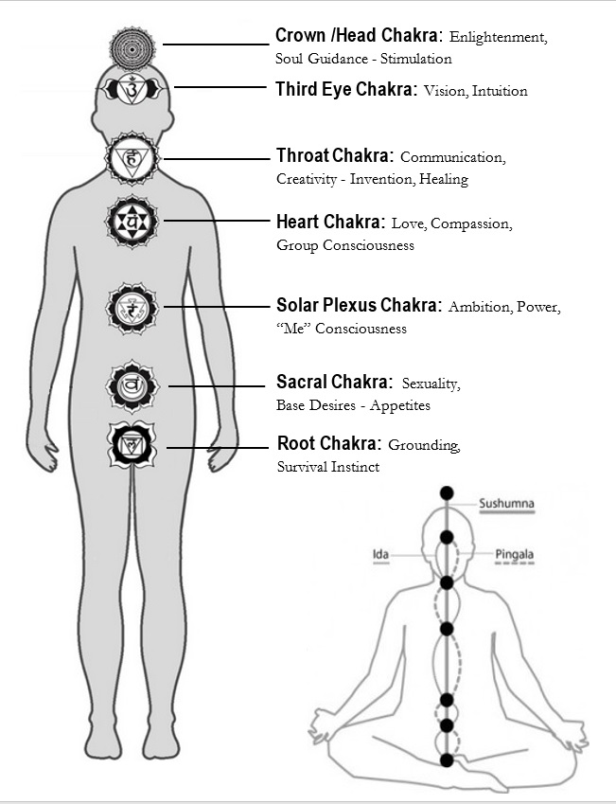
Right Energy Flows
Notes:
For Posture: It’s best to place the body in a upright position where the body is relaxed, but cannot fall asleep. The vertical uprightness of the body allows for the subtle energies between and around the chakras to flow properly. [see HANDOUT]
Regarding chakras or centers……Briefly the Chakras Purpose is for regulation of Glands, provide vitality and prana flowing to the Etheric Body…..and allows for Soul stimulation.
I’ll be discussing the Human Constitution, the etheric body and the chakras in more detail in December’s talk.

Slide 18
Identifying Goals in Meditation
Create Alignment
Experience Beingness
Notes:
Identifying Goals in Meditation
We have identified that the main purpose of meditation is to establish a direct connection with the Soul. Now, it is important to identify realistic goals for yourself and conduct an honest assessment of yourself by asking the following questions:
Why are you meditating?
What are your motives, attitude, goals and purpose as you enter meditation?
Answering this helps you to establish a “Mental Approach”.
What keeps you from realizing the oneness with your Soul? If you find a limitation, such as a fear, anger, etc., then what are you doing about transforming the energy?
So an initial goal of meditation is to create an alignment of all parts of the Personality (i.e. mental, emotional, physical) and see yourself as ONE with the Soul. This will be done in stages.
Identify with concept that the Soul’s energy is a “Tension” in consciousness.
Another goal in Meditation could be to directly experience a state of Beingness of Higher Self and sensing a pure awareness without thought. This will entail developing an inner capacity for inner seeing and listening. As you progress on the Path, you will learn that observation and listening are very similar, e.g. meditate in silence and “listen”….for impressions from you Higher Self.

Slide 19
Object of Concentration
What to Focus On?
“Concentration is Not Meditation”
Retrieve Ideas and Impressions
Notes:
Object of Concentration
When speaking of an object of concentration in meditation, you want to focus your attention towards an object to aid in focusing the mind….to prepare for meditation
A sacred image (e.g., a candle, or a picture or image of Evolved Being)
Focus on the breath (e.g., pranayama or rhythmic breathing)….this can create a calming sensation in the mind and Etheric and physical form.
Sounding To deepen your meditation, you can use a Seed Thought in meditation, e.g., affirmation, mantra or chant [HANDOUT]
“I and my Soul are One”, “I am love, truth, and beauty”, etc.
This exercise can be useful to eliminate hang-ups, angers and fears.
You’ll have to experiment to find out what’s right for you.
Understand that concentration is not meditation. You use concentration to discipline the mind and hold your initial focus and to develop comprehension.
Meditation begins after the tension of concentration is released. At that moment there is no thought of feeling but a “SPACE” in awareness between them. That space is a state of Beingness and is a significant goal to achieve.
After reaching a meditative state, you can retrieve impulses coming from the Soul. These are called impressions. They can be ideas, insights, wisdom, guidance, etc.
In advanced stages of meditation, this awareness becomes more regular and inevitably becomes a “Continuity of Consciousness”…..see [”Terminology” Handout] for definition.

Slide 20
Stages of Meditation
Developing Clear Seeing
Notes:
Stages of Meditation
In reviewing Becoming the Observer and Meditation processes, we understand that a major purpose of meditation is to achieve an alignment and integration of your 3-Fold nature with that of the Soul. This should be your initial goal. Much later, you will learn that it is your pure Spirit, or Monad which is the true guiding energy.
Meditation is a process that prepares the mind for clear seeing on different levels of the mental plane, and later the Spiritual Triad. Achieving deep spiritual connections with the higher Self will require time and effort. In this journey, there are stages you will go through to achieve the higher connections. Each stage is characterized by removing obstacles that block clear seeing and there are changes or expansions of consciousness along the way.
After a measure of purification, you can begin to experience Pure Awareness and a direct experience of your higher Self in its natural state free of the distractions of the lower energies.
You begin to see that you have a choice and that you do not have to be controlled or disrupted from every thought of feeling. Thus, you can learn to hold your consciousness peacefully. The meditation process is also a means to slow down and observe how the mind works.
In the [Handout] “Stages of Meditation, the various stages are generally described of what the Probationer to disciple to Initiate will experience over time. I’ve provided this as supplemental reading.

Slide 21
Handout:
‘Techniques for Working in Consciousness
Notes:
[Handout] Techniques for Working in Consciousness
To conclude the discussion on confronting hindering or disrupting thoughts, you the spiritual seeker need to have tools if you are to successfully complete your work for removing those obstacles or veils that block clear seeing of the Soul’s pure awareness.
Reference the [Handout] “Techniques for Working in Consciousness”. It is a list of tools and techniques that you can use for overcoming hinderances and difficult energies in consciousness:
‘As If’ (substitution) technique – It is very much like pretending or acting out a specific energy, such as cooperation, acceptance or goodwill. It is the concept of invoking the polar opposite energy or force for a positive outcome. This requires invoking the personal will. Also, practicing dispassion, can help you to think clearly by negating the negative emotions.
Technique of Light - This is a mental technique for purification where you the spiritual seeker are confronting a limitation in your own mind or astral body. This technique can also be applied to negating glamour and illusion.

Slide 22
Technique of Light
This technique describes how the light of the Personality (lower mind), and the light of the Soul merge together to transform the energy of the illusion. It can also be used for re-patterning thoughtforms.

Slide 23
Technique of Light
Become the observer and see the emotion / illusion dispassionately.
Visualize the Soul’s light combined with your personality, creating one powerful floodlight shining on the illusion.
Sincerity is key.

Slide 24
Handout:
‘Techniques for Working in Consciousness
Cont ‘ d
Notes:
Overcoming Fear – Fear happens to all of us, and can even be felt by high level initiates. It will only be overcome by bringing forth the Soul’s light of truth and awareness. In the teachings, it is recommended to deal with a problem energy from one level above. (TWM + GWP books)
In this case, mentally force out the fear by the dynamic power of substitution. This is similar to the Technique of Light…..How does this work?
Become the Observer and separate yourself from the fearful feeling or situation, and willfully relax your physical and astral bodies. Perhaps, you can control your breathing. Then invoke stillness in the mind thru concentration and permeate the entire personality with pure white light. This is a process of invoking the higher Will for calming your lower (mental, emotional, physical) vehicles. This is a mental exercise.
Complete identification with the pure awareness of the Soul – the more the person connects with the Soul or higher awareness thru meditation or in outward service activity, the more it will help to displace and replace the lower energies blocking clear seeing and knowing.
Focusing on Higher Values – Higher values, such as love, compassion, cooperation goodwill, harmlessness, a sense of justice, and practiced goodness will go a long way towards offsetting the lower energies of selfishness, fear, and anger.
Analyze and identify negative energies (whether yours or theirs) – When you feel a negative energy in consciousness, analyze it as the Observer, and try to determine its source. Again, you can invoke the polar opposite to overcome the energy. This is a form of substitution.
You are developing the ability or faculty for working with abstract ideas and concepts.

Slide 25
“On Becoming the Observer” Meditation
Notes:
On Becoming the Observer meditation.

